Slide 1
Real time shadows
Pranabesh Sinha

Slide 2

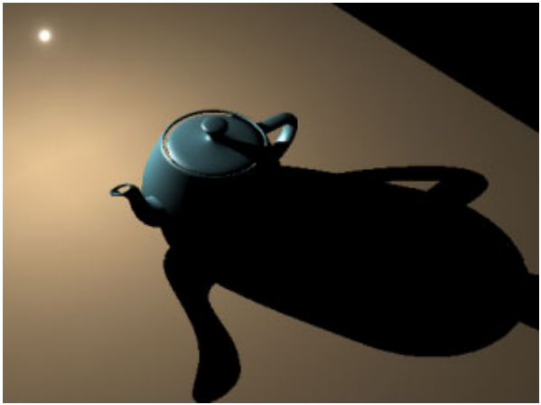
Who needs shadows anyway
Shadows add realism
Adds visual cues

Slide 3
Common Techniques
Shadow Maps
Shadow Volumes
Ray Tracing (side effect)

Slide 4
Shadow Maps
Image based
Fast, ideal for static lights and objects
Supported by hardware
Can be extended to approximate
Shadows from area lights
Soft shadows

Slide 5
Depth Buffer
2D array of floating point numbers [0-1]
Usually tested against itself
Types of depth tests
Less than (or equal)
Greater than (or equal)
Equal
Not equal

Slide 6
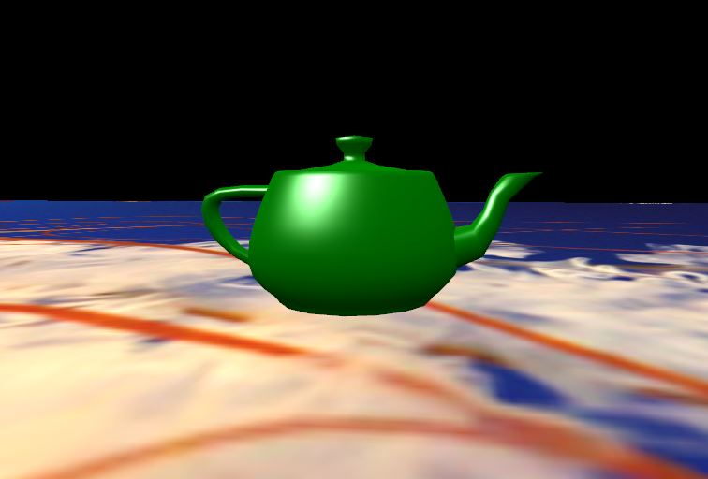
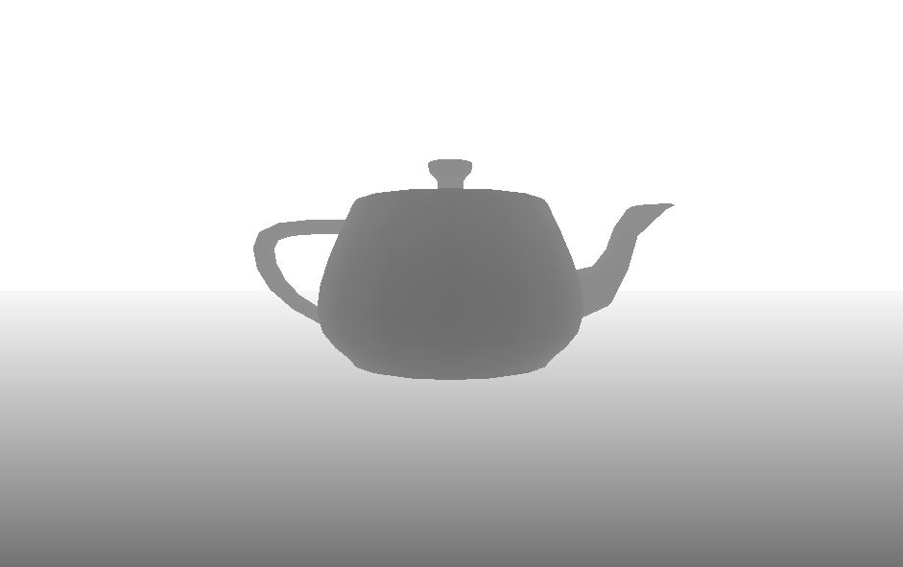
Depth Buffer

Slide 7
Basic Algorithm
Put camera in light’s position
Record only depth, store in FBO
Put camera back to view position
Render scene normally and use depth from FBO as texture
Depth of fragment > depth in map ?
No
Yes
Fragment is not in shadow
Fragment is in shadow

Slide 8
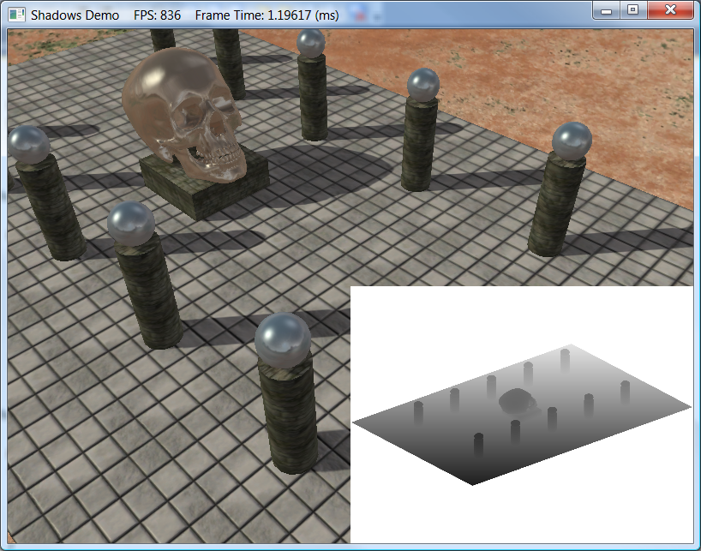
Basic Algorithm
Notes:
Image source: Introduction to 3D Game Programming with DirectX 11

Slide 9
Framebuffer Objects
Results of rendering to framebuffer can be directly used as texture
Consists of a collection of logical buffers
Colour, Depth, Stencil
When FBO is bound, its attached images are source and destination for fragment operations
Notes:
Faster than previous technique of rendering to colour buffer and copying over the data

Slide 10
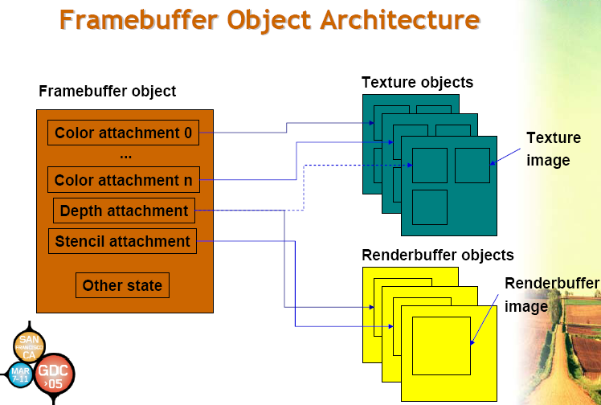
Notes:
Image source: http://http.download.nvidia.com/developer/presentations/2005/GDC/OpenGL_Day/OpenGL_FrameBuffer_Object.pdf

Slide 11
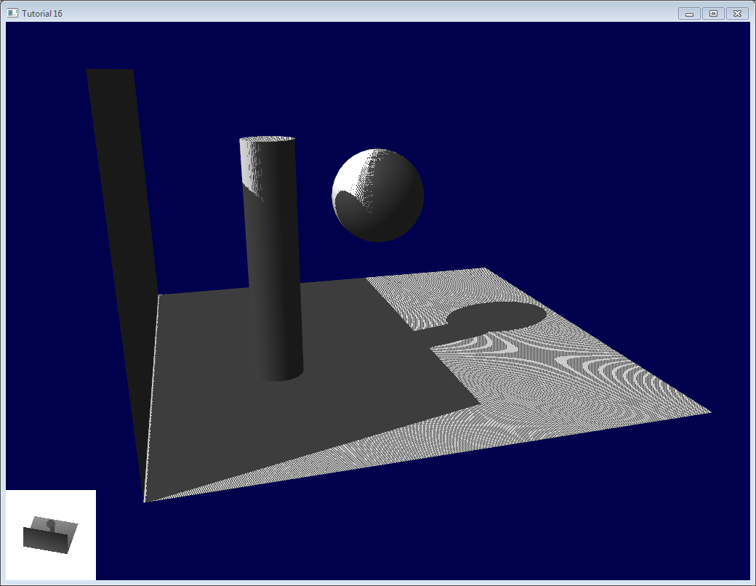
Drawbacks of Shadow Maps
Shadow Acne
Notes:
Image source: http://www.opengl-tutorial.org/wp-content/uploads/2011/08/1rstTry.png

Slide 12
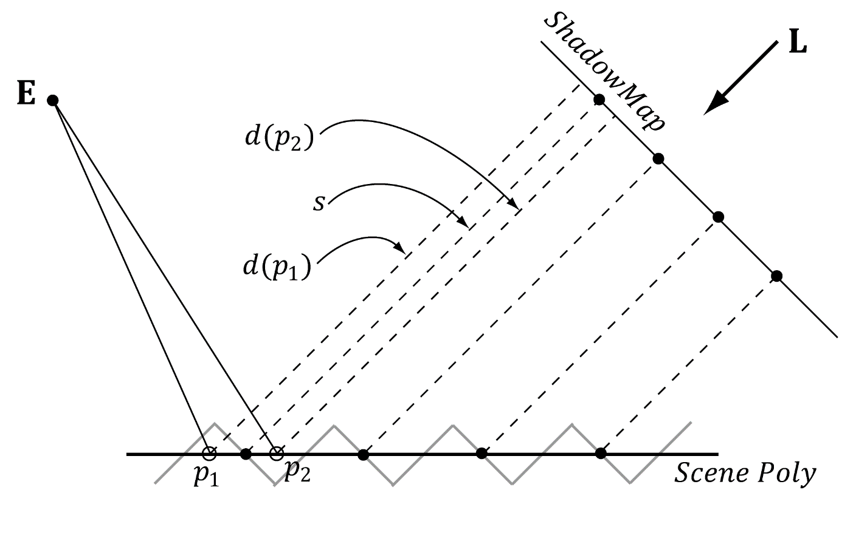
Drawbacks of Shadow Maps
Shadow Acne
Notes:
Image source: Introduction to 3D Game Programming with DirectX 11

Slide 13
Drawbacks of Shadow Maps
Shadow Acne
Notes:
Image source: Introduction to 3D Game Programming with DirectX 11

Slide 14
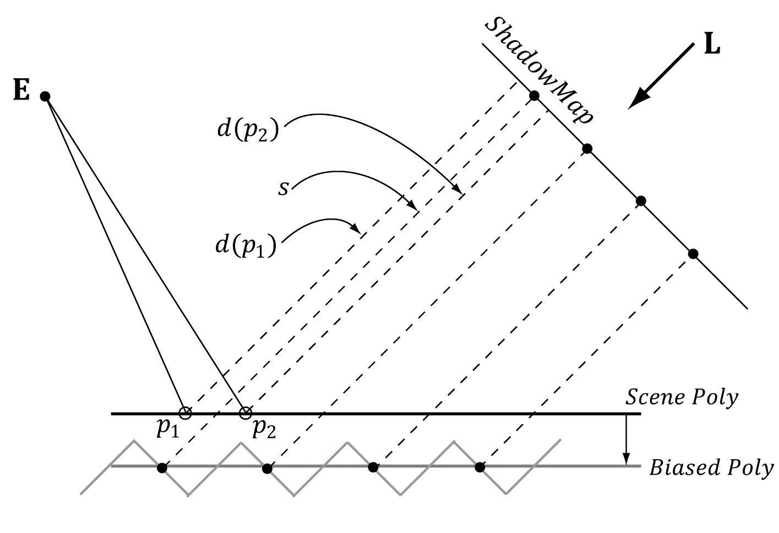
Drawbacks of Shadow Maps
Apply a bias
Notes:
Image source: Introduction to 3D Game Programming with DirectX 11

Slide 15
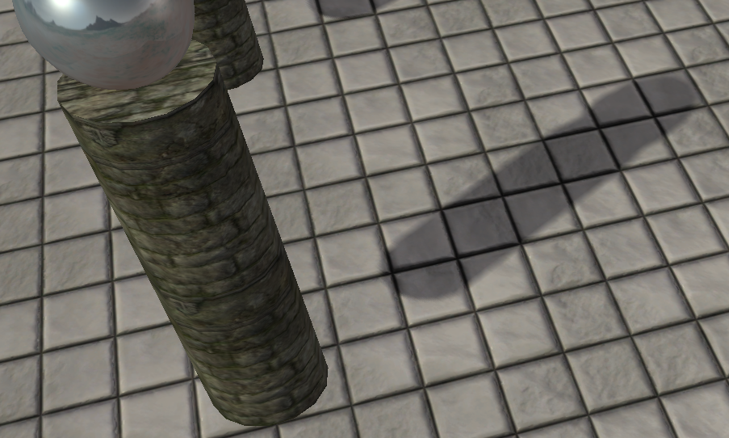
Drawbacks of Shadow Maps
Peter Panning
Notes:
Image source: Introduction to 3D Game Programming with DirectX 11

Slide 16
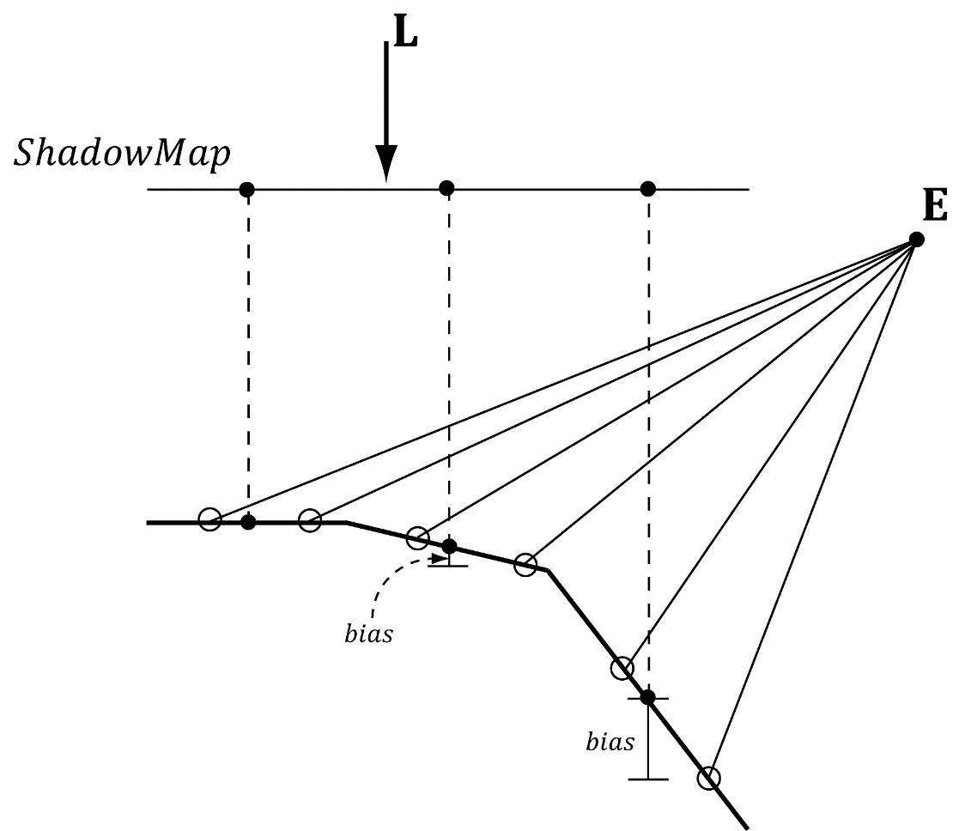
Drawbacks of Shadow Maps
Sloped surfaces
Notes:
Image source: Introduction to 3D Game Programming with DirectX 11

Slide 17
Drawbacks of Shadow Maps
Hardware Support
D3D11RASTERIZER_DESC
{
[…]
INT DepthBias
FLOAT DepthBiasClamp
FLOAT SlopeScaleDepthBias
[…]
}

Slide 18
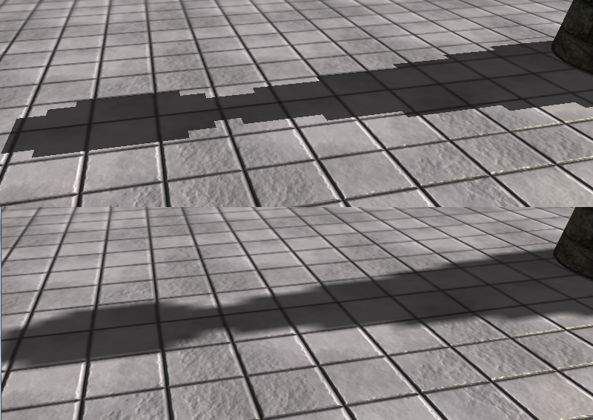
Percentage Closer Filtering
Notes:
Image source: Introduction to 3D Game Programming with DirectX 11

Slide 19
Percentage Closer Filtering
Performs linear interpolation between
(u,v), (u+∆x, v), (u, v+∆x), (u+∆x, v+∆x)
∆x = 1/SHADOW_MAP_SIZE
Sampling textures is expensive
Hardware supports PCF directly via SampleCmpLevelZero method

Slide 20
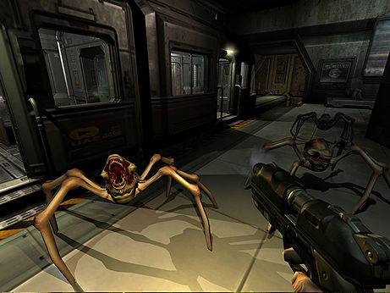
Shadow Volume
Volumetric shadow algorithm
Eliminates the problem of self shadowing
Good candidate for geometry shader
Popularized by Doom 3
Notes:
More accurate than shadow maps but slower
Image source: wikipedia

Slide 21
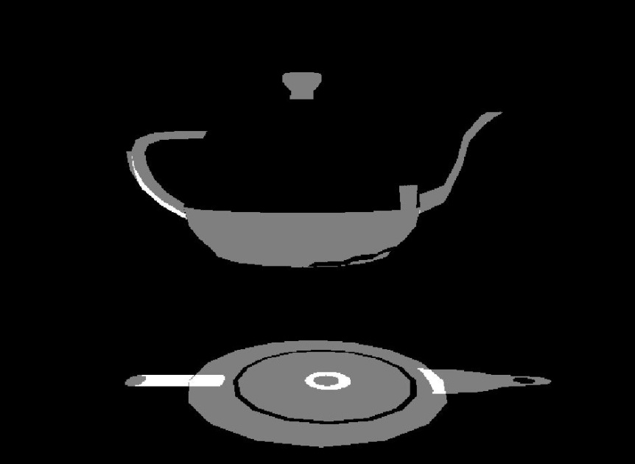
Stencil Buffer
2D array of signed integers
Types of tests
FrontFace_StencilDepthFailOp=INCR
BackFace_StencilDepthFailOp=DECR
Notes:
Most common use of a stencil buffer is in car racing games where you’d want to render the back scene in the rear view mirror.

Slide 22
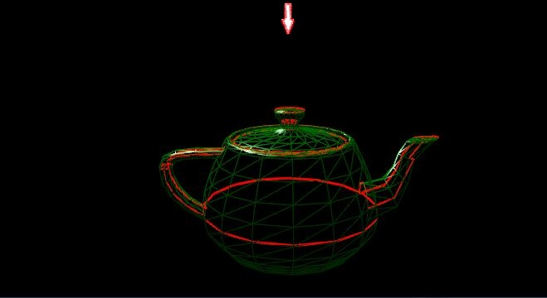
Silhouette determination
The edge beyond which there is shadow

Slide 23
Silhouette determination
Initialize contour list
For each triangle
If 0<= Angle(Incident light, Triangle Normal) <= 90
For each edge of triangle
If edge already in contour list
Remove it
Else
Add it

Slide 24
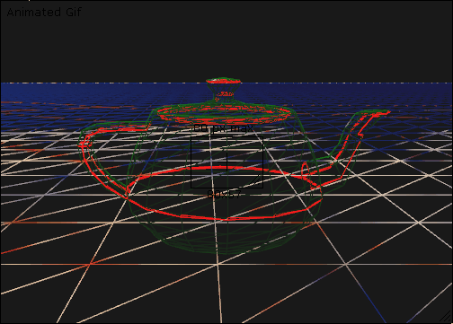
Silhouette extrusion
Extend the silhouette in the direction of light
Notes:
Think of the silhouette as new polygons, which can be rendered in two passes. In front pass you cull back faces in second pass you cull front faces.

Slide 25
Find Silhouette
A
Render basic scene with ambient light
Disable colour buffer and depth buffer writes
Fragment passes depth test?
Draw extruded surface, cull back faces
Yes
Fragment passes depth test?
Decrement Stencil buffer
Yes
Enable colour buffer and depth buffer writes
Increment Stencil buffer
Fragment passes stencil test?
Draw extruded surface, cull front faces
A
Render basic scene with diffuse light

Slide 26
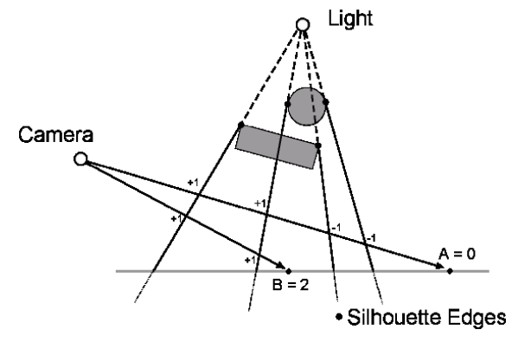
Basic Algorithm

Slide 27
More Reading
Basic algorithm without GS - http://nuclear.mutantstargoat.com/articles/volume_shadows_tutorial_nuclear.pdf
With GS – http://http.developer.nvidia.com/GPUGems3/gpugems3_ch11.html

